Slide 1
Hi guys
Please ensure you have either Chrome or Firefox installed. (if you don’t have either, I question your life choices.) I will be using Chrome to demonstrate, but Firefox is close enough.
Those who are new and didn’t come last week, please do the following:
Install one of these:
Atom (Recommended for Mac)
Brackets (Recommended for Windows)
Notepad++ (for advanced users masochists)
Make friends with someone who came last week and knows their stuff
We start at 7:10. Today’s session might be slightly longer.

Slide 2
3DC Web Dev Series
Part 2 – Introduction to CSS and the Developer Tools*
*if we spend more than 2 hours on CSS, I will save this for next week.

Slide 3
Continuation from last week – font colours
You can set font colours using the following style property:
color:green
/* Note the murican engrish spelling: “color” not “colour” */
You can use either the common names in Engrish names “red”, “green”, “blue”, but to specify an exact colour you’ll need to use colour codes.

Slide 4
Specifying Colours in CSS
RGB Hex codes are a universal (but “old”) way computers use to specify colour.
A hex code consists of 3 2-digit hexadecimal numbers (starts from 0, ends at F – in decimal 0 to 255) to specify how much red, green and blue (primary colours) the colour should contain.
#FFB3AC
Start with a #
AC = 172
~67% blue
FF = 255
100% red
B3 =179
~70% green
Trivia: You can specify up to (16²)³ = (2⁸)³ colours in this notation. This is what computers mean by “24 bit color.”

Slide 5
Specifying Colours in CSS – cont.
You can specify RGB values in a “newer” format using decimal numbers instead of hexadecimal in the format below:
rgb(123,45,67)
#7B2D43
Start with rgb(
~18% green
~52% red
~22% blue
Close the bracket!

Slide 6
Specifying Colours in CSS – cont.
As an extension, you can specify opacity using the RGBA format, as a number between 0 and 1.
rgba(123,45,67,0.5)
#7B2D43
+50% transparent
Start with rgba(
~18% green
~22% blue
~52% red
50% transparent
Close the bracket!

Slide 7
Text Formatting in CSS - Fonts
You can change the font of the text using the font-family style declaration.
<span style=“font-family:’Times New Roman’”> Hello World </span>
You must quote the name of the font if it contains spaces or numbers, and the quotes used must differ from the quotes used to quote the style attribute.
<span style=“font-family:Helvetica,’Times New Roman’”> Hello World! </span>
Tries to use Helvetica (Apple font), but if the user doesn’t have the font installed, it falls back to Times New Roman.

Slide 8
You can also provide the name of a generic font family, and let the browser / operating system choose on its own.
Font-Family | Description
serif | Glyphs have finishing strokes, flared or tapering ends, or have actual serifed endings.
sans-serif | Glyphs have stroke endings that are plain.
monospace | All glyphs have the same fixed width.
cursive | Glyphs in cursive fonts generally have either joining strokes or other cursive characteristics beyond those of italic typefaces
fantasy | Fantasy fonts are primarily decorative fonts that contain playful representations of characters.
system-ui | Glyphs are taken from the default user interface font on a given platform.
<span style=“font-family:’Ubuntu Mono’,monospace;”>Hello World! </span>
Tries to use ‘Ubuntu Mono’, but if it is not installed, let the system choose its default monospace font.

Slide 9
Specifying sizes in CSS
CSS has different units you can use for lengths, heights and font sizes.
The most commonly used unit was px for pixels, but making responsive sites completely in pixels is difficult because the size of one pixel differs per device.
The common ones are shown below:
Unit symbol | Meaning
% | Percentage of the parent element
em | Multiplier of font-size of the current element
vw | Percentage of the screen’s width
vh | Percentage of the screen’s height
vmin | Percentage of the screen’s smaller dimension (either width or height)
vmax | Percentage of the screen’s larger dimension (either width or height)

Slide 10
Different ways to insert CSS
You may have noticed by now that inserting CSS directly into your elements is extremely tedious.
What if you have multiple elements you want to apply multiple styles to?

Slide 11
Different ways to insert CSS
Inline CSS
Inline CSS is inserting CSS directly into the HTML element using the style attribute.
<h1 style=“font-size:50px;font-family:Times New Roman”> A poem for you </h1>
<p style=“font-family:comic-sans”>
Roses are <span style=“color:#FF0000”>red</span> <br>
Violets are <span style=“color:#0000FF”>blue</span> <br>
Tears are salty <br>
And so am I
</p>
Gets pretty messy doesn’t it?

Slide 12
Different ways to insert CSS
Internal Stylesheets
Instead, you can place your style declarations inside a <style> tag inside the <head> HTML section.
<html>
<head>
<style>
/* your css here */
</style>
</head>
<body>
<h1> A poem for you </h1>
<p> Roses are <span>red</span>… </p>
</body>
</html>
But how does your CSS know which elements to target?

Slide 13
Internal Stylesheets
An internal stylesheet look like this:
span {
font-size:20px;
font-family:”Times New Roman”;
padding-left:10px;
padding-right:10px;
}
Selector
A rule to tell the browser how to select elements to style
Style Declarations
Tells the browser what styles to apply (change colour, font etc)

Slide 14
CSS Selectors – Element Selectors
Selectors are extremely important as you need to correctly tell your browser which elements should the following styles apply to.
The selector below applies the styles below to all <span> elements.
span {
font-size:20px;
font-family:”Times New Roman”;
padding-left:10px;
padding-right:10px;
}

Slide 15
CSS Selectors – Descendant Elements
Successive element type names separated with a space denotes child elements.
This selectors targets <a> tags only if they are nested inside <p> elements.
p a{
color:#00FF00;
}
<p><a>This</a> will get turned green</p>
However, <a>this</a> will not be affected.
However, it will also target non-direct descendants.
The following rule is stricter and requires that the second element specified must be a direct child of the first element.
p > a{
color:#00FF00;
}
<p><a>This</a> will get turned green</p>
<p><span>However, <a>this</a> will</span> not be affected.</p>

Slide 16
CSS Selectors - IDs
Useful as they are, Element selectors are hard to control because they affect all the matching elements on the page. IDs let you change only one element.
#title {
font-family: ”Times New Roman”;
font-size: 20vh;
color: #FF0000;
padding: 0px 10px 10px 10px;
}
<h1 id=“title”> A poem for you </h1>
<p> Roses are red….. </p>
HTML in body
CSS in header
Your browser will look for an element with the id attribute “title”.
IDs must be unique and one-to-one.

Slide 17
CSS Selectors - Classes
As an alternative to IDs, classes let you assign a bunch of styles to multiple elements without being as overreaching as using element selectors.
.colours {
font-family: “Comic Sans”;
font-size: 10px;
}
<h1> A poem for you </h1>
<p> Roses are <span class=“colours”>red</span></p>
<p> Violets are <span class=“colours”>blue</span></p>
CSS in header
HTML in body
Unlike IDs, classes of the same name can be assigned to multiple elements, and you can assign multiple classes to one element.

Slide 18
.colours {
font-family: “Comic Sans”, fantasy;
font-size: 10px;
}
.flowers {
font-family: “Ubuntu Mono”, monospace;
font-size: 10px;
text-decoration: underline;
}
<h1> A poem for you </h1>
<p><span class=“flowers”>Roses</span> are <span class=“colours”>red</span></p>
<p><span class=“flowers colours”>Violets</span> are <span class=“colours”> blue </span></p>
Be careful about conflicting style declarations. The later CSS declarations will take precedence.

Slide 19
CSS Selectors – Combining Everything
p .flowers{
/* This targets all elements with classname “flower” inside a <p> element. */
}
p.headers .flowers{
/* This targets all elements with classname “flower” inside a <p> element that has the classname “headers”. */
}
span.colours.flowers{
/* This targets all <span> elements with BOTH classnames “colours” and “flowers”. */
}

Slide 20
The CSS box model
Every single element on the webpage is rendered as a box. This includes text, images and even empty space.
You can add ”invisible space” around this box using different properties of the CSS box model.
Webpages are effectively just boxes inside boxes inside boxes stacked next to each other.
Understanding this model and being able to deduce (or at least guess) how these “boxes” are stacked just by looking at the page is imperative in web development.

Slide 21
The CSS box model
Padding: transparent space to put around the content
Border: the layer outside the padding that can be coloured.
Margin: more transparent space outside the border. Margins of different elements can overlap with each other.
All of these are optional, and you can specify sizes in each specific direction.

Slide 22
The CSS box model – so what?
Your web browser will try to stack the boxes as close to each other as possible, overlapping margins wherever possible.
Therefore, if you want to separate elements, you need to change the properties of each box such as the padding or the margin.
In case of unequal margins, the element with the larger margin will take precedence.
How would your browser arrange these elements to save as much space as possible?

Slide 23
No padding, border or margin
Only left element has padding-bottom and padding-right
Left element has padding and coloured border, right element has padding-left
Reminder: padding is transparent and border is coloured

Slide 24
With margin, border and padding
Reminder: margins merge!

Slide 25

Left margin (“empty space”)
Actual content
Right margin (“empty space”)

Slide 26
<img src=“sutd_logo.png”
style=“padding-left:20px;
padding-right:20px;
padding-bottom:10px;”/>
20px
20px
10px
<span
style=“padding-left:20px;
padding-right:20px;”>
Please select from the following login options
</span>
20px
20px

Slide 27
Left padding (“empty space”)
Actual content
Right padding (“empty space”)
Also empty space??
Padding will push other elements away!

Slide 28
The <div> element
The <div> element is similar to your <span>, it is a generic empty element for you to logically separate elements on the page.
You can put elements inside a <div> and apply attributes such as padding or margin to move all of them at once.
Unlike <span> however, <div> is a block level element: its default width is always set to 100%. (i.e. it occupies the full width of the parent) If you want to change this you must use the width CSS property.
This is similar to how <h1> will push other elements below itself.

Slide 29
Box display types
This attempts to answer why tags like <h1> and <p> take up their own special line while elements like <span> do not.
The browser can render the boxes in a few different modes, inline, block and inline-block.
This is defined by the display CSS property, and some HTML elements have block set as default (but can be overridden in your stylesheets.)

Slide 30
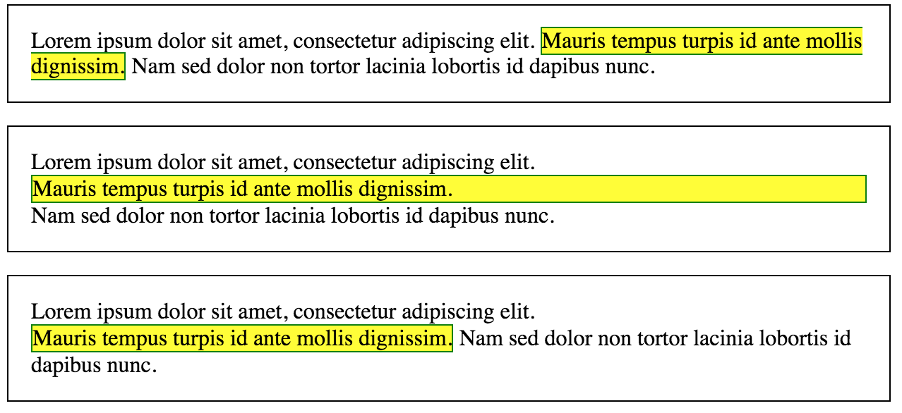
Box display types
Inline
Block
Inline-Block

Slide 31
Box display types
Inline
Flows with the surrounding elements and text
Content will be broken across lines if there is not enough space
width and height cannot be set

Slide 32
Box display types
Block
Gets its own line
Content will not “spill over” to other lines
Width will be set to 100% of parent (by default)
width and height can be set via CSS

Slide 33
Box display types
Inline-Block
Flows with the surrounding text and elements
Content will not “spill over” to other lines
Width will be set to match content by default (auto)
width and height can be set via CSS

Slide 34
Box display types
Elements that are display:inline by default
Elements that are display:block by default
<span>
<em>
<b>
<strong>
<img>
<div>
<p>
<h1> <h2> <h3>
<ol>
<ul>
<li>

